Slide 1
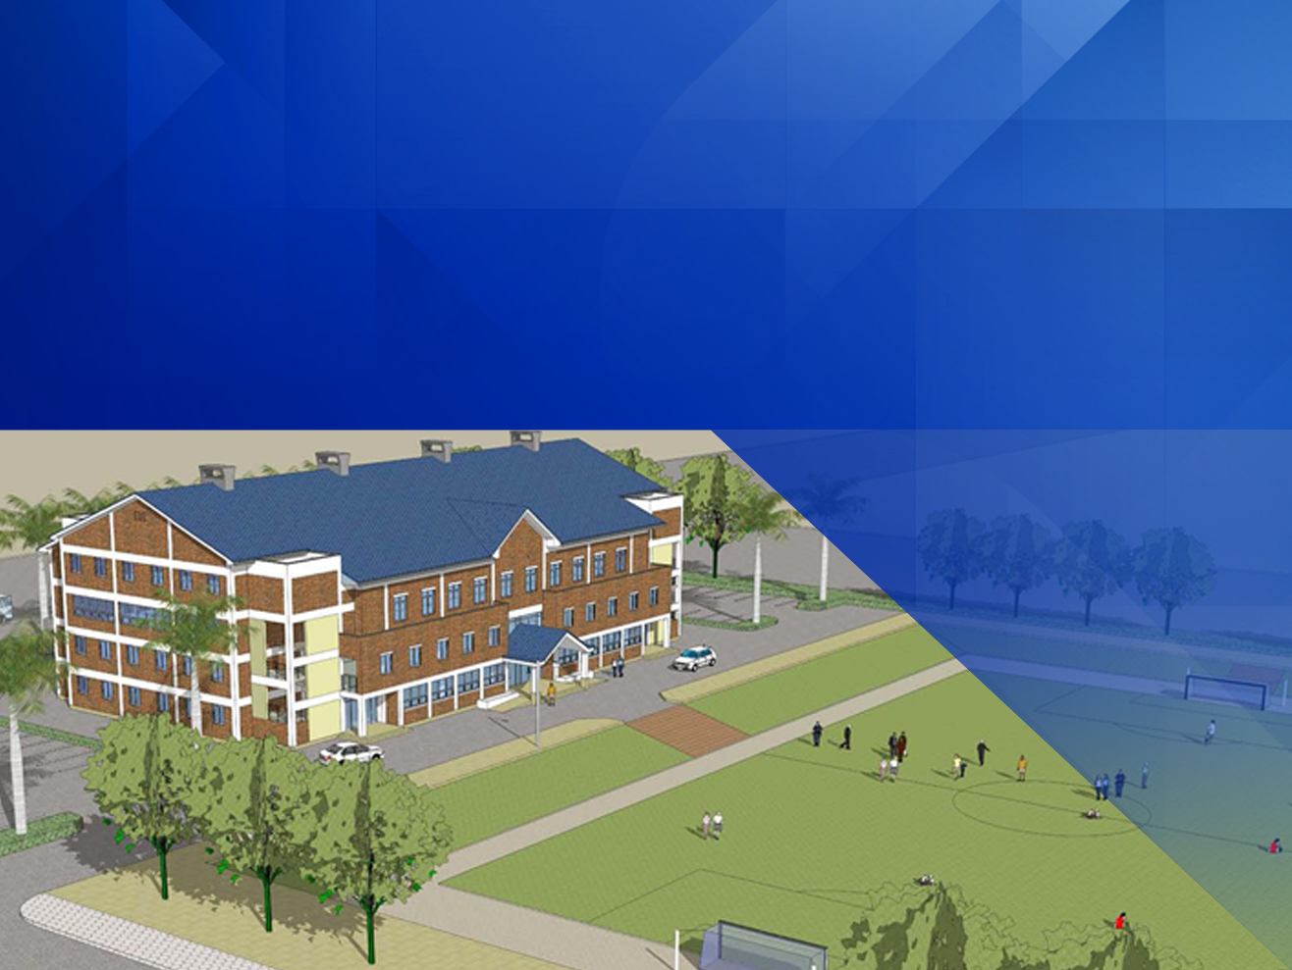
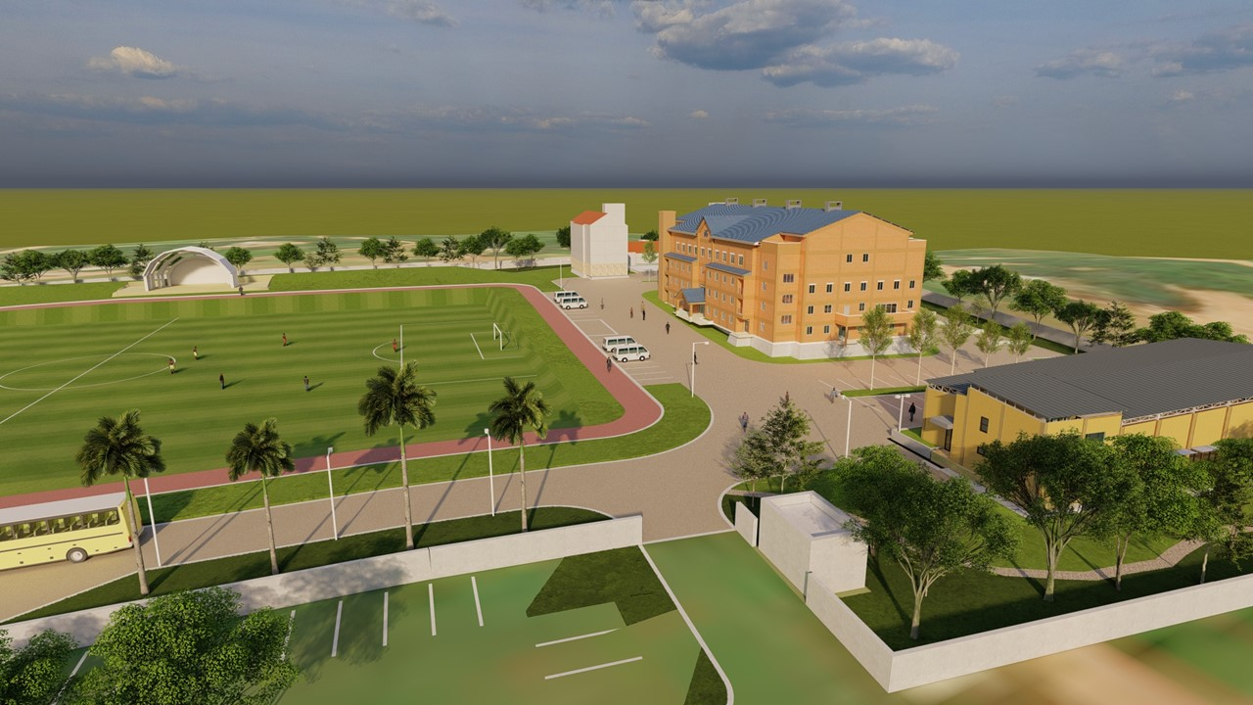
Ghana Accra Youth Center Construction Sponsorship Proposal
Ghana Youth Special Mind Project to Cultivate Global Leaders
(It may differ from the picture)

Slide 2


Contents
01 Organization Introduction
- Iyf
- Programs
02 Motivation
- General
- Background
- Problems
- Solutions
- Summarized Systematic Approach
- Main Activity and Goal
- Goal Analysis
03 Introduction of Country
- Overview of Ghana
- Current Status Of Accra Area
04 Contents of Project
- Purpose and Content Of Project
- Facilities and Details
05 Project Plan
- Implementation Schedule Plan
06 Project Budget
- Budget List

Slide 3
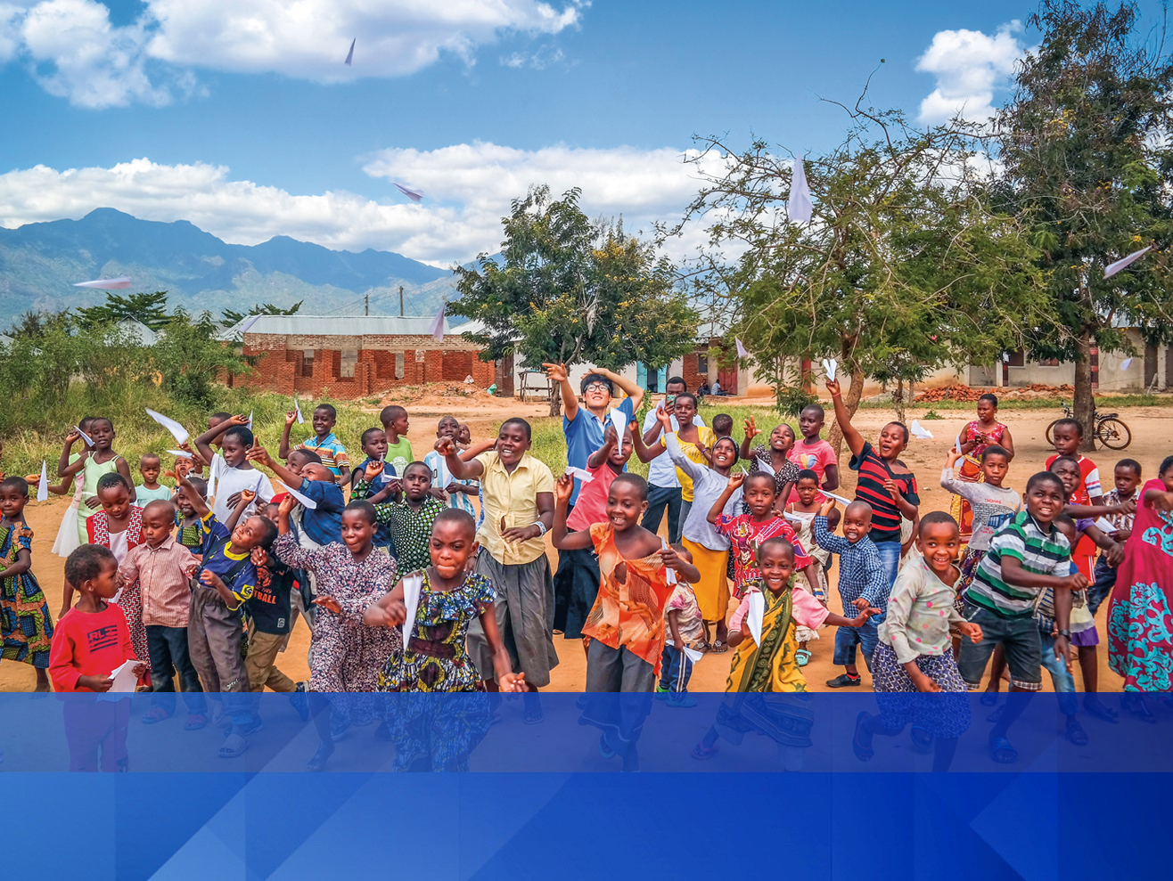
01 Organization Introduction
01 Introduction of Organization

Slide 4

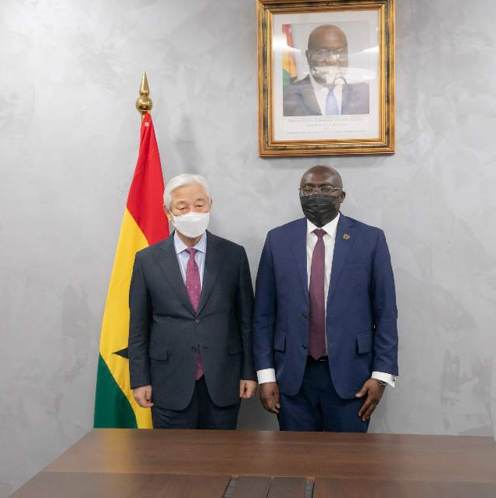
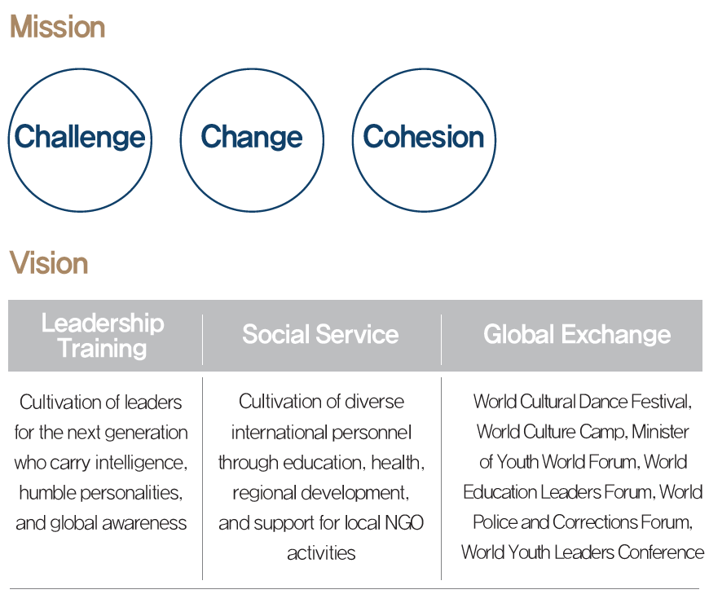
01 INTRODUCTION ｜ IYF
International Youth Fellowship
Worldwide
Branches Details
IYF was established in 2001 as an International youth organization and NGO based on a Christian mindset, to raise leaders with a global insight through international cultural exchange activities and provide realistic solutions to youth problems in the global village.
89Countries
206Branches
IYF founder Rev.Dr. Ock Soo Park &
Vice President of Ghana Mahamudu Bawumia
November 2021

Slide 5
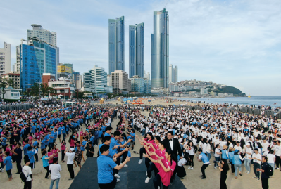
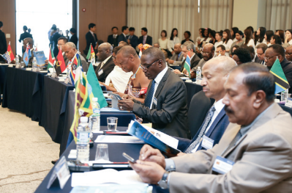
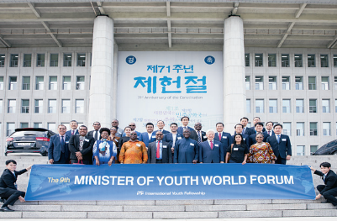
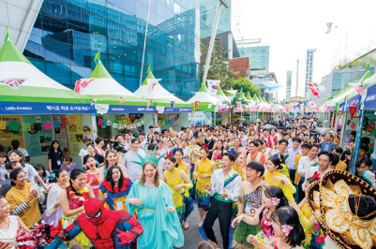
01 INTRODUCTION ｜ IYF
Programs
Global Education, Social Service, International Exchange, Cultural Exchange, Foreign Exchange
01 World Culture Camp
02 World Education Leaders Forum
-Hosted “World Culture Camp,” a platform of exchange for the global youth.
-Held in more than 95 countries annually.
-A place of exchange for the global development of
university students and education
-Hosted annually since 2013 with over 60 participating
university chancellors
03 Ministers of Youth World Forum
04 World Culture Expo
-Introduction of culture and customs of each country experienced by the youth
-Exhibition of each continent and country’s culture (clothes,food, traditional props, memories, etc.)
-World culture performance (traditional songs, dance, recital), world culture experience event
-Built a network to resolve global youth issues
-Hosted annually since 2011 with ministers from
25 participating countries

Slide 6
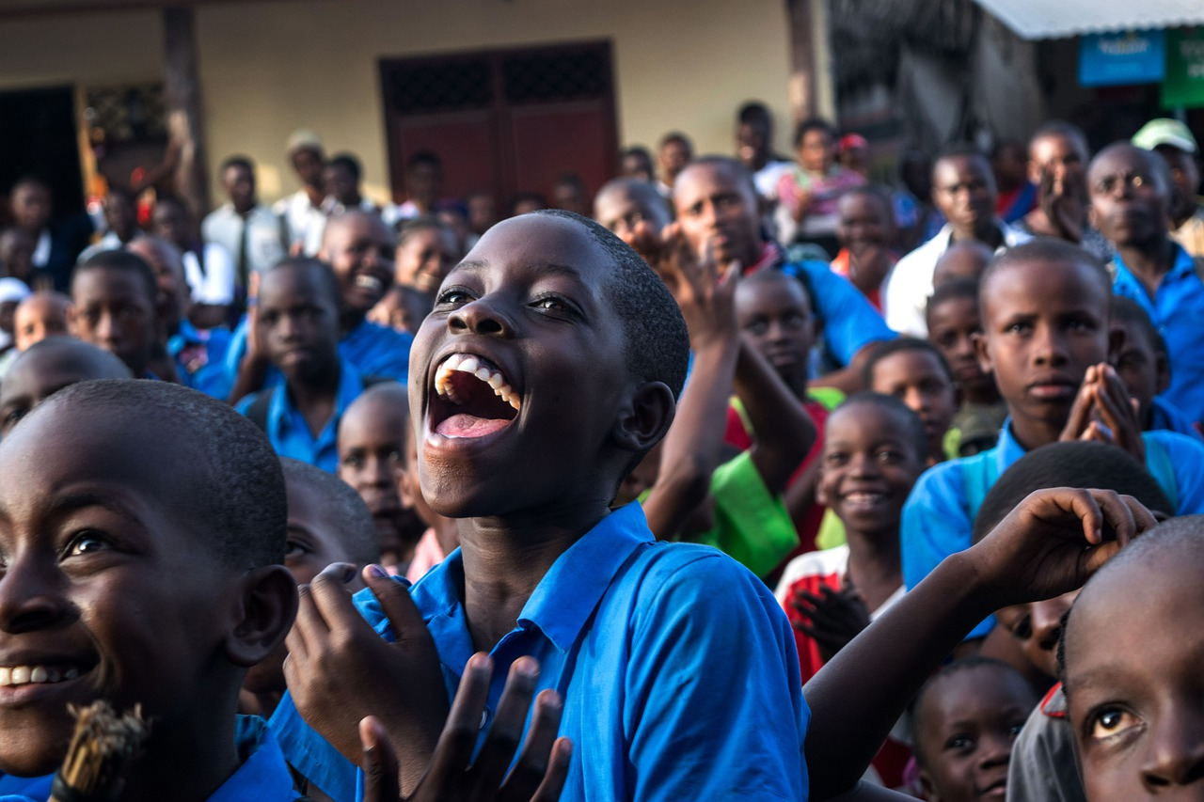

02 Motivation

Slide 7
02 MOTIVATION
General
Country/Region
Ghana, Accra(Capital)
Project Necessity
There is no youth center to foster healthy youth.
Youth are the future of the country. The right education of young people can change a country.
Project Period
1Year 6Months
Target
Nurturing and supporting Ghanaian youth who will lead the future of the country
Detail
Plan
Facility
    1st Block : Multipurpose Mind Education Auditorium
    2nd Block: Global Leader Training Room, Mind Basic Education Room,
      .Mind Higher Education Room
    3rd Block: Academy Classrooms, Living Facilities, Playground
Budget
3,000,000 $

Slide 8
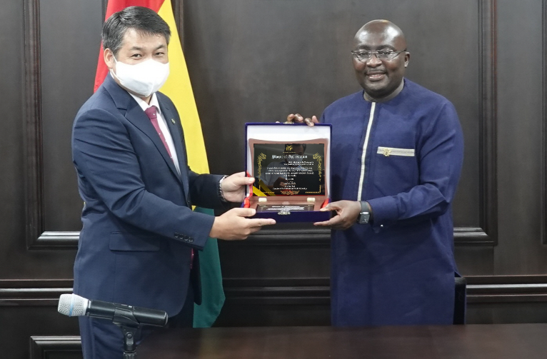
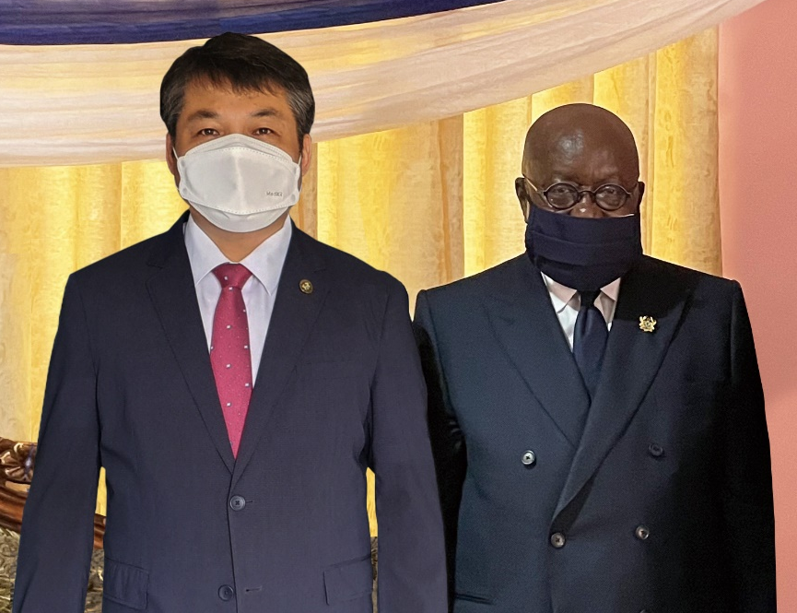
02 MOTIVATION
Background
IYF have been conducting youth education and cultural exchange activities in Ghana for over 20 years.
The International Youth Fellowship (IYF) was recognized by the Ghanaian government and a cooperative network was formed.
After that, the President and the government requested the IYF to contribute to the education and development of youth through the establishment of educational and social infrastructure.
Ghana Vice President Mahamudu Bawumia and Ghana Branch Director David Oh
IYF profile in Ghana
2001 Established IYF in Accra, Ghana
2008 ~ Annual holding the IYF world camp in Ghana
2011 07. Minister of Youth visited South Korea
2017 07. Meeting with the President of Ghana
Request of establishment of youth center
2021 11. Meeting with the Vice President of Ghana to
discuss the construction of the Youth Center
03. Interview with the President of Ghana Request
to build a youth center
Ghana President Nana Akufo-Addo and Ghana Branch Director David Oh

Slide 9

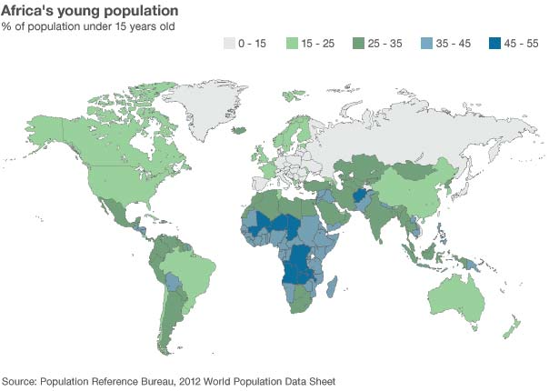
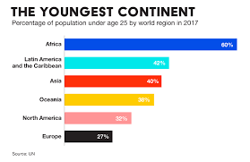
02 MOTIVATION
Problems
Africa records the most youthful population so far.
Advantage or Disadvantage?

Slide 10

02 MOTIVATION
Problems
The Advantage or Disadvantage will be based on only
one factor. Succeeding or failing to make this youth
active. Youth are the leaders who will lead the country
of the future.
But Youth problems are getting worse. Unemployment,
Criminal, drug addiction, gambling addiction, teenage mothers
Making youths active brings two great challenges;
Creating the requested amount of job
Absence of willing mind to work or be educated
These are the greatest problems in youth problem solving because its failure leads to increased number of social vices.

Slide 11
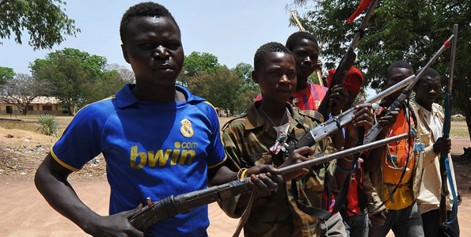

02 MOTIVATION
Solution
Adequate approach: Dream Care System
By technical analysis, creating jobs will only be a partial solution.
But an adequate approach to this problem will be to create a system that could promote dream nurturing in the youth, because loss of dream or purpose is such a great cancer that can harm a youthful society. (Eg; adolescent rebels)
On the contrary, a dream nurturing system produces a very active and willing self-innovative youth, gearing an automatic development to such a country.
By so doing, instead of a high youthful population issue becoming a curse, it rather becomes a blessing

Slide 12
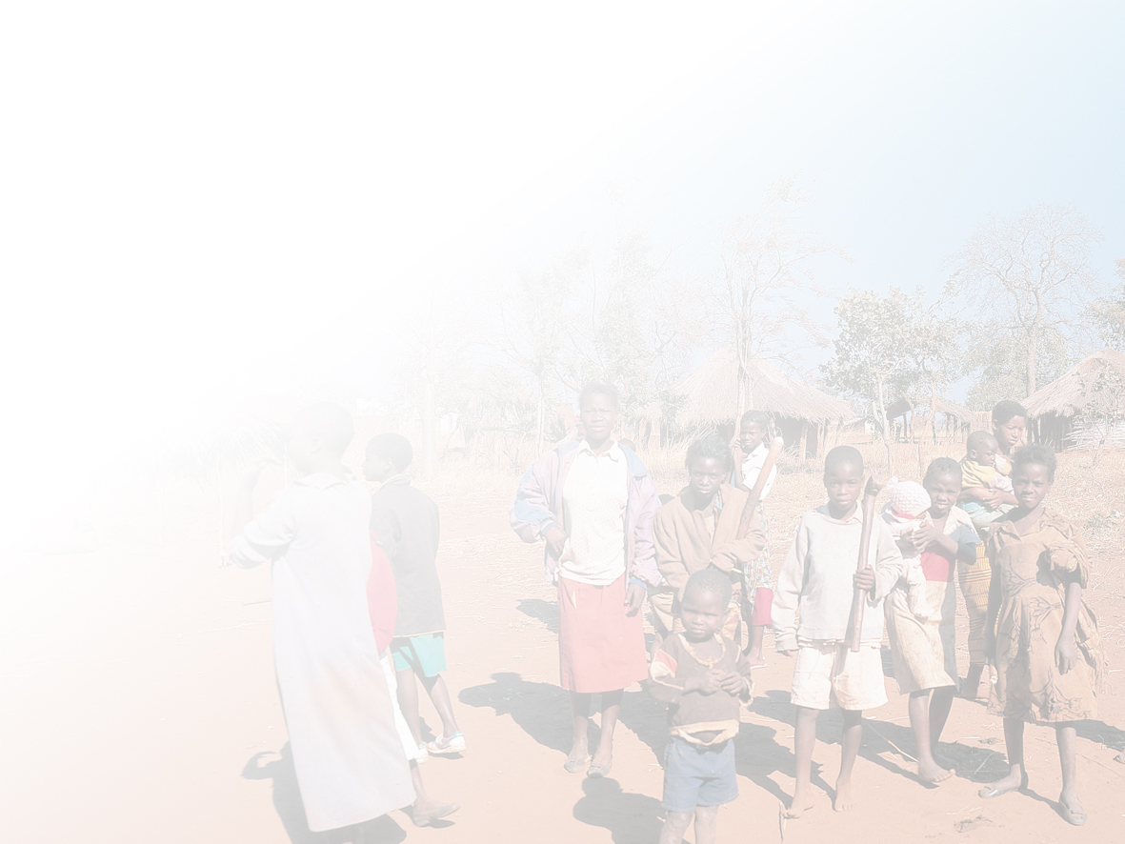
02 MOTIVATION
Summarized Systematic Approach
Issues and various approaches
Youth Problems
Government’s interventions
IYF Approach
Education related problems
Job related problems
Free SHS
1D1F and NABCO
Dream nurturing through soccer Academy
Mindset Education centers

Slide 13
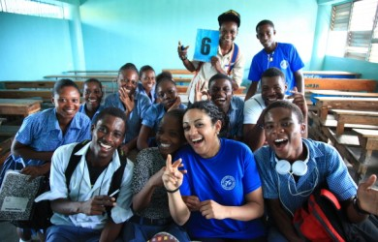
02 MOTIVATION
Main Activity and Goal
Build Youth Center | Operational plan establishment | Staff Education training | Develop educational program
Provide space for youth activities | Upgrade the operating plan & youth planning establishment | Providing opportunities for various leisure activities for youth
Youth grow up healthy and local communities are revitalized

Slide 14
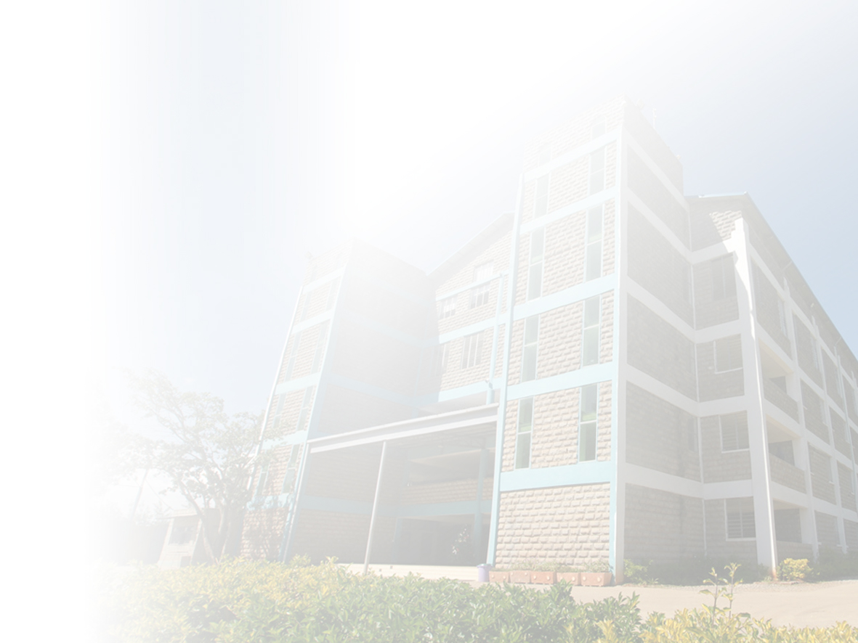
02 MOTIVATION
Goal Analysis (Medium and long term impact in the society)
Capacity building of Youth and citizens
Providing a good out of school education
Soccer
promotion
Increasing capability as a member of society
Improvement of alternative educational environment
Improvement of quality of alternative education
Providing soccer clinicals assistance
Improvement of soccer theorical studies
Psychological relaxation & improvement of self-esteem
Expansion of youth’s entry into society
Building center
Physical education & art academy
Coaching assistance
Soccer school education
Mind education
Vocational & Technology education
Support materials
Cultural exchange programs
Practical soccer programs (leagues)
Mentor-Mentee program
Education for resident
Education for women

Slide 15
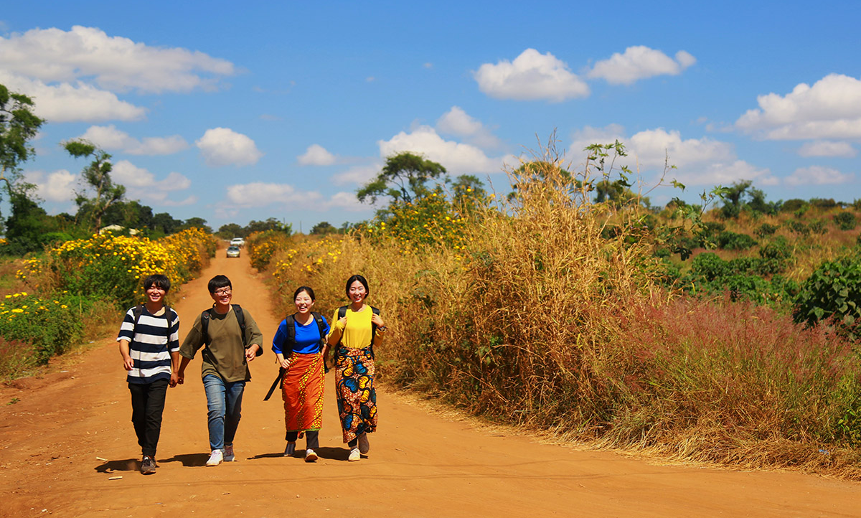
03 Introduction of country

Slide 16
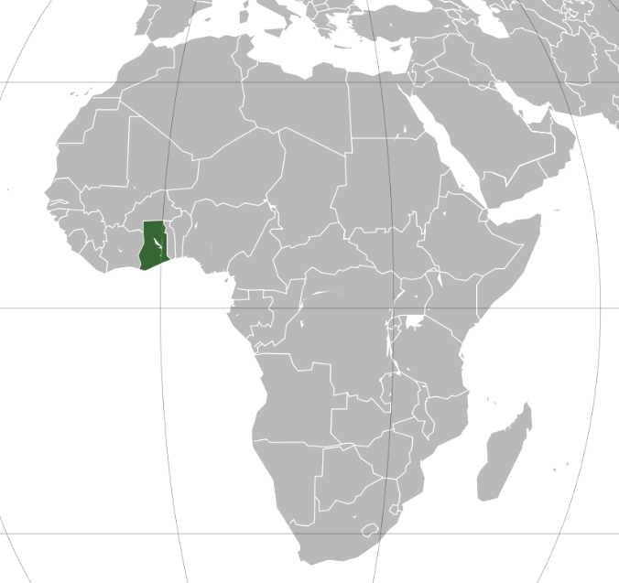

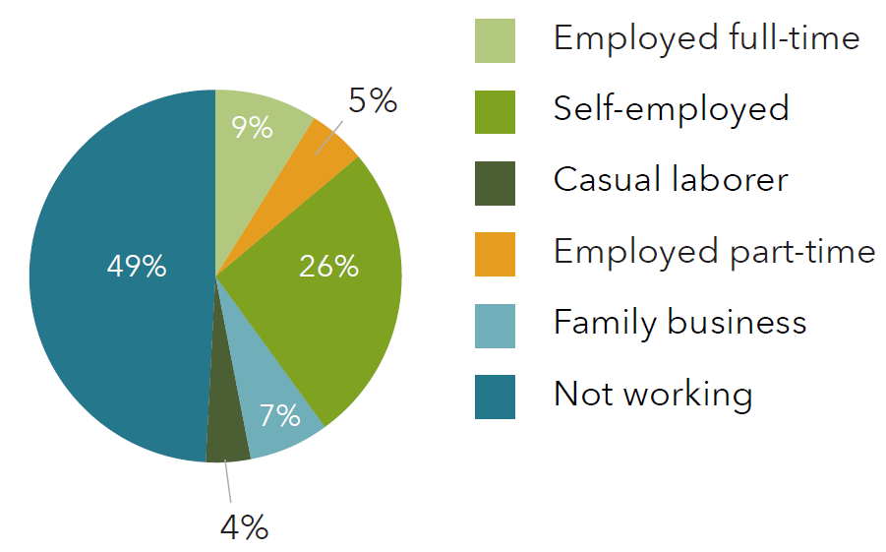
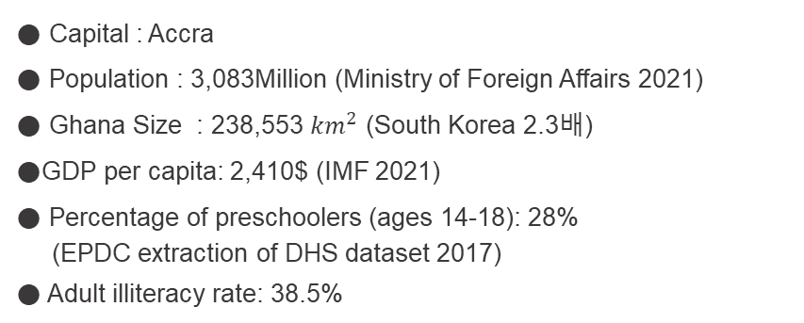
03 INTRODUCTION OF COUNTRY
Overview Of Ghana
● Capital : Accra
● Population : 3,083Million (Ministry of Foreign Affairs 2021)
● Ghana Size : 238,553 ${km}^{2}$ (South Korea 2.3배)
●GDP per capita: 2,410$ (IMF 2021)
● Percentage of preschoolers (ages 14-18): 28%
(EPDC extraction of DHS dataset 2017)
● Adult illiteracy rate: 38.5%
● Among preschoolers, 51% are in education and employment, only 7% are full-time workers, and 4% are working part-time. Others help with family businesses (6%) or do temporary work.(Youth Map Assessment Report_2018)
Notes:
도표 옆 수치 재검토

Slide 17
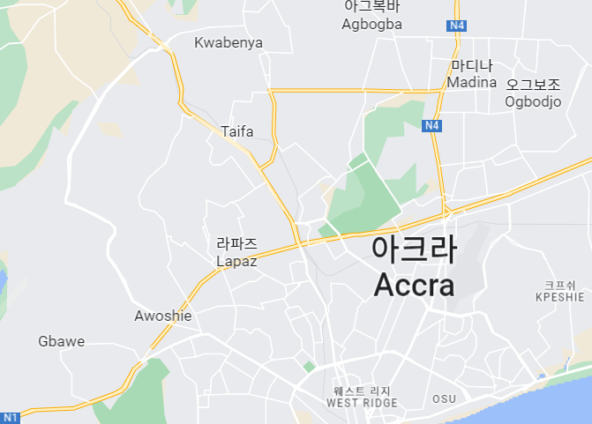
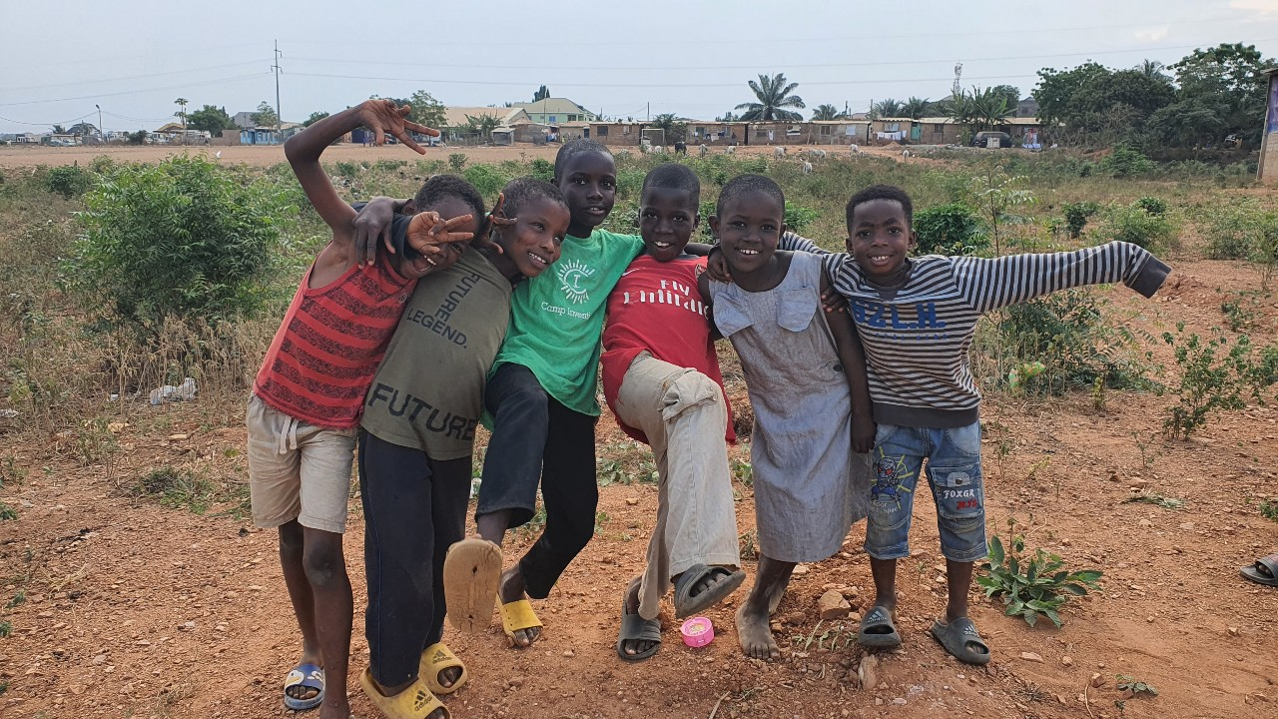
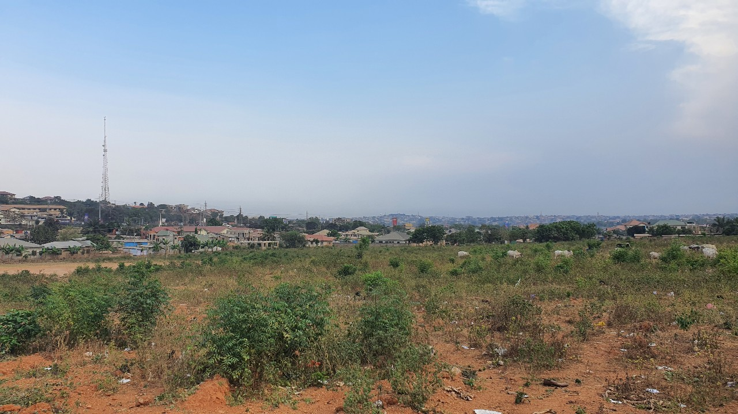
03 INTRODUCTION OF COUNTRY
Current Status of Accra Area
● Population: 10,052,711
● Youth population : 3,728,321
● Accra Asofan
- Lack of facilities for youth
- Needs youth center for all students
- Regular special programs after school, vacations
- Located in the most convenient place for accra
citizens to access
Site slum children
Building Lot (5 acres)

Slide 18
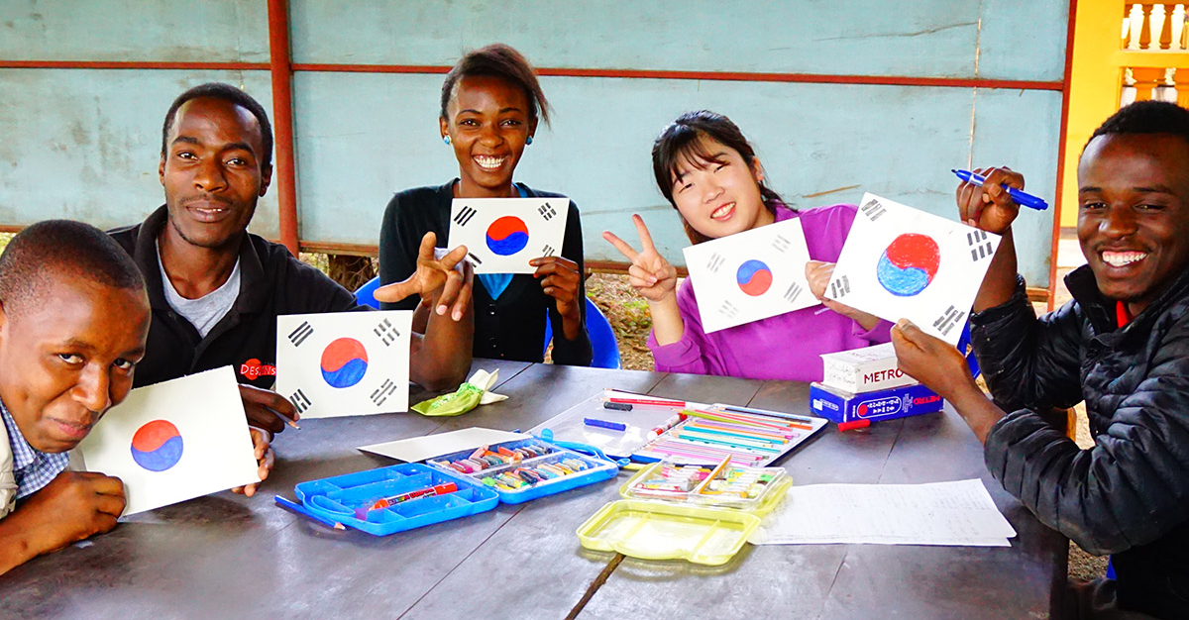
04 Contents of Project

Slide 19



04 CONTENT OF PROJECT
Purpose and Content of Project
Promoting healthy growth of children and youth through building of Schools, Youth Care Centers and various programs.
Mind Care Center
Mental Health : Providing education and facility for right character
building most needed in becoming member of
society
○ Program : Mind education and career consulting etc.
Dream Care Center
Social Health : Contributing to nurturing competent individuals of
professional field by providing education of various
fields.
○ Program : Job & Technology School and various academy classes etc.
Soccer
Academy
Physical Health : Challenging the youth to overcome their limits and aim high to obtain optimum physical and mental levels.
○ Program : Soccer schools and continental competitions

Slide 20



04 CONTENT OF PROJECT
1st Block : Mind Care Center
● Multipurpose Mind Education Auditorium (2,000 Capacity Main Auditorium)
● Strengthen ability of youth and residents of Accra as member of society
Mind Care Center
Project Specifics
Youth mind education : Youth Global Leader Camp, Global leader training, Mind Recreation, Teenage single mother education, Job creation education
Mind education (teachers, public official, government employee, businessman)
Hold small events for district residents
Develop social adjustment training program for out of school youth
Operate mind education program for youth
Operate program for enhancing parents awareness
Facilities and Primary Function
Counseling office | Career counseling, Psychology consultation, Personal & Group Counseling etc.
VIP Room | Reception room, Meeting room of YCC staff
Main Hall | Multipurpose hall
Dormitory | Dormitory for YCC staff

Slide 21

04 CONTENT OF PROJECT
2nd Block : Dream Care center (School)
● Provide a school of good education and environment.
● Expand alternative education opportunity and support quality education program of Accra children and youth,
Project Specifics
School - Provide a good educational environment for local students (Kindergarten, Primary School, JHS, SHS)
Operate job & technology school
- Operate academy programs for out of school youths by dispatching professionals and volunteers
(Taekwondo, computer, language, broadcasting technology etc.)
Provide opportunities for various cultural arts and sports activities
Dream Care Center
Facilities and Primary Function
School | 3 story building (Kindergarten, Elementary School, JHS, SHS)
Audiovisual Room | Increase effects of learning activities between teacher and student by utilizing audiovisual material
Multimedia Room | Computer lectures of information, media, and video related activity space through internet information search, produce data for information sharing service, multimedia material production activities
Academy Room | classrooms
Library | Provide various books and other material

Slide 22
04 CONTENT OF PROJECT
3rd Block : Soccer Academy
Project Specifics
Establishment of alternative school
- Soccer Academy: Lecture rooms for theorical soccer education
-Technical institution: machinery, architecture, computer, broadcasting technology
(long term project)
-Music school: music practice rooms equipped with soundproof facilities etc.
Establishment of indoor Gym
Soccer Academy
Facilities and Primary Function
Soccer Classroom | Soccer Field, Lecture rooms
Fitness Room | sports equipment
Office | main administrative work management
Local Community Room | meeting and administrative space for local community

Slide 23
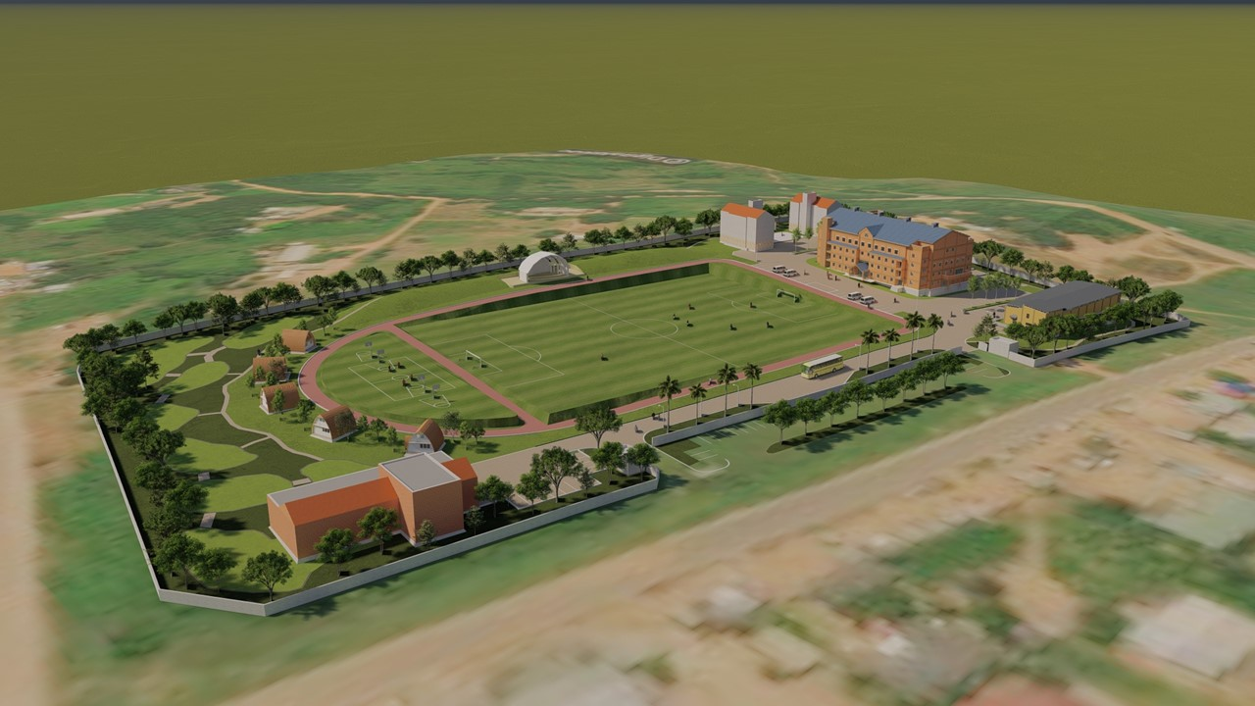
(It may differ from the picture)
05 Project Plan

Slide 24
05 PROJECT PLAN
Project Plan
Project Plan | A |  | B |  | C |  | D
 | 1 | 2 | 3 | 4 | 5 | 6 | 7 | 8
Execution plan Establishment
Find a location
Construction design
Selection of construction Company
Construction
Dispatch Superviser of Project
Training Staff
Supply of Materials
Operation
Project Completion ceremony and closure
Evaluation

Slide 25
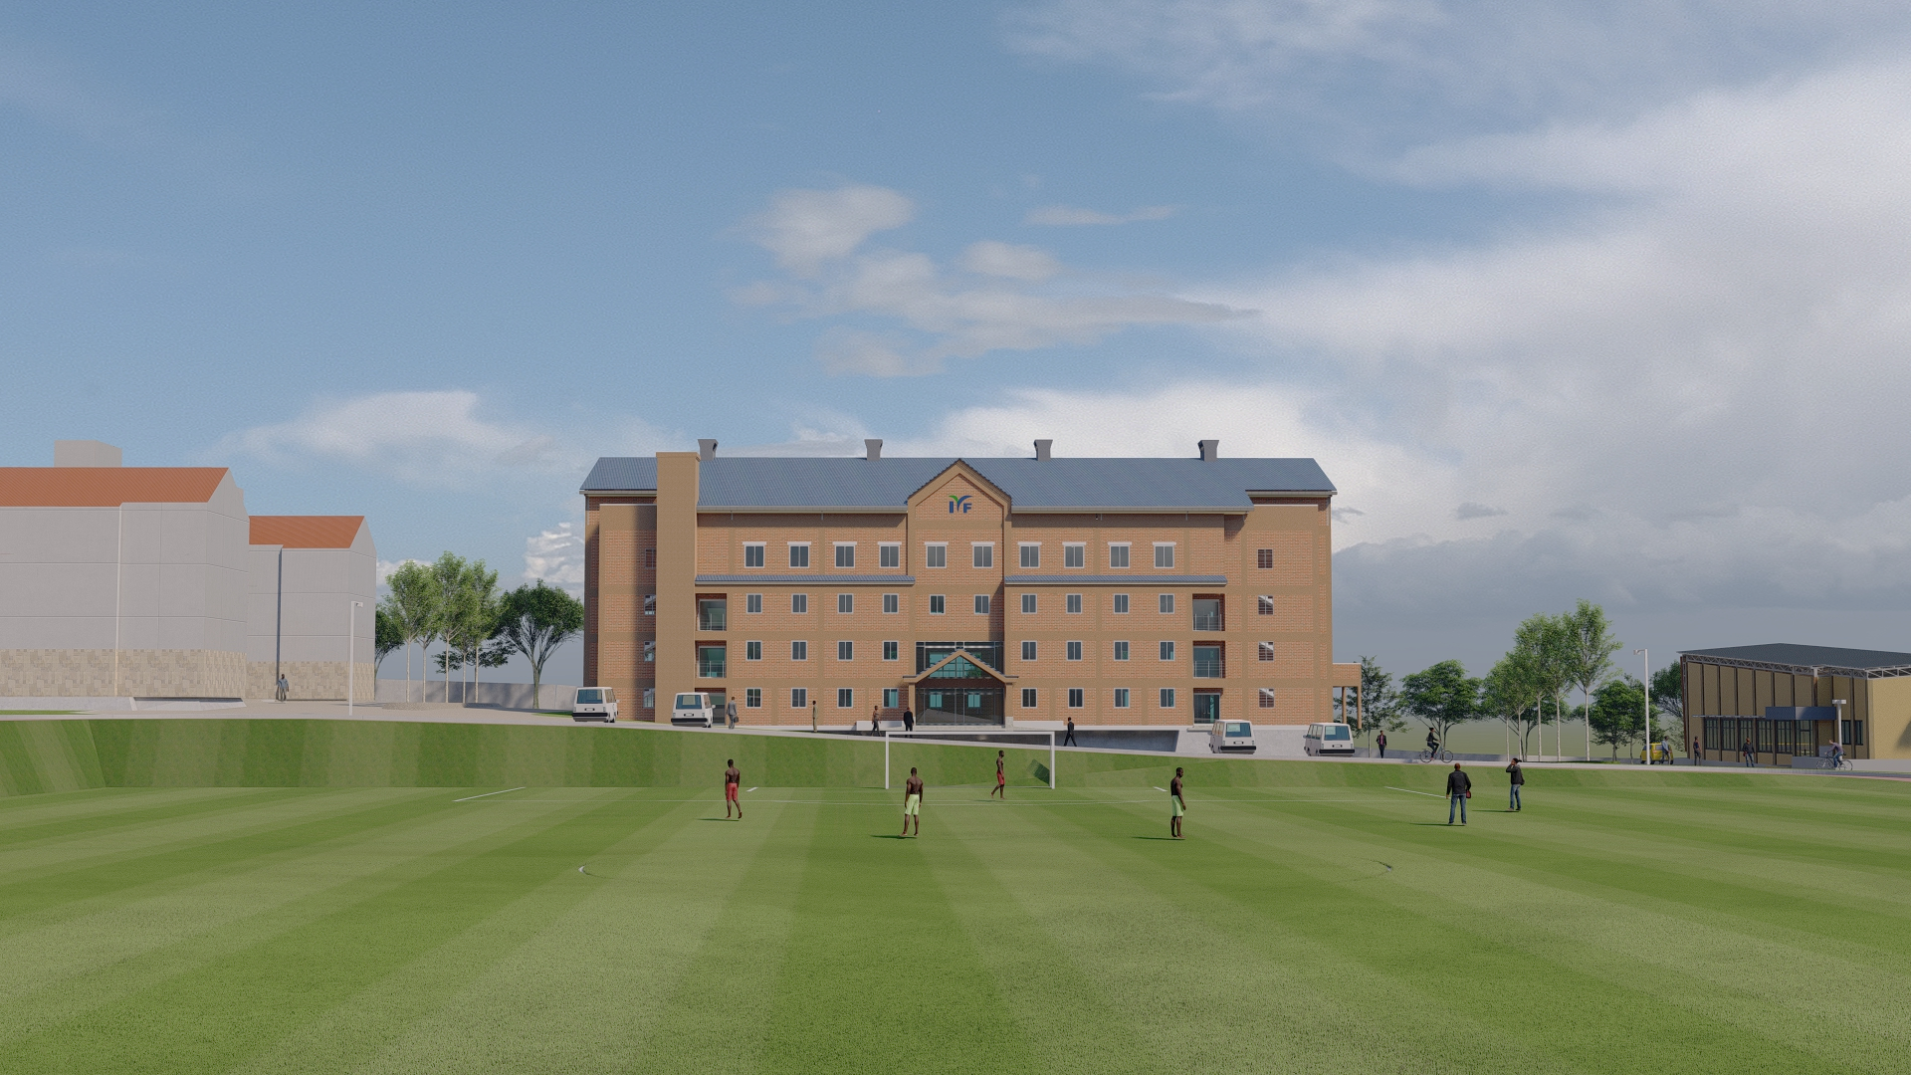
06 BUDGET LIST
Detailed Plans
(It may differ from the picture)
06 Budget list

Slide 26
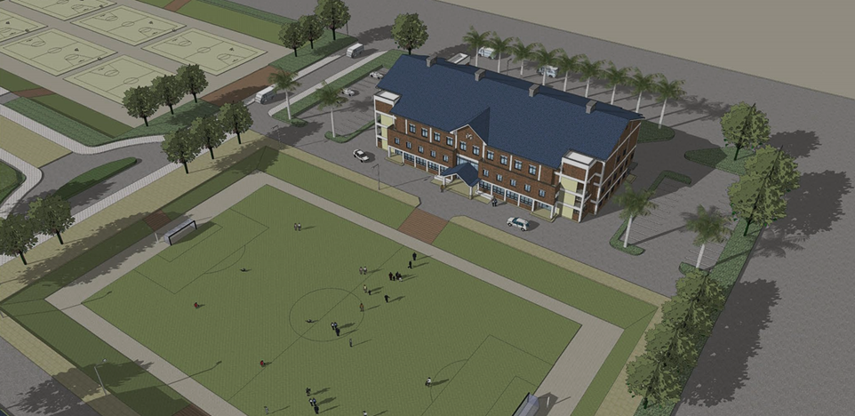
06 BUDGET LIST
Budget List
1st
Block
Auditorium 2,600,000 $
    1. General Lecture Hall with 2,000 seats (USD 1.2Million)
    2. Mind Academy Training Venues (3 venues with 100 seats each / 3 venues with 200 seats
    each - USD 0.33 Million)
    3. Conference Room, Cafeteria, Dining Hall, Offices, Lounge, Video Room, Medical Room,
    Broadcast Room (USD 0.33 Million)
    4. Broadcasting Equipment, Training Materials, Vehicles (USD 0.13 Million)
    5. Parking Lot, Landscape, Security Room, Field (USD 0.17 Million)
    6. Accommodation for Teachers and Students (USD 0.18 Million)
    7. Rooms for Professors and Lecture Preparation (USD 70,000)
    8. Operation Costs (USD 15,000)
2nd
Block
School 400,000 $
    1. Kindergarten, 300 primary-high school students
    2. Classrooms, Principal’s Room, Teachers’ Room, Administration Office, Science Room,
    Medical Room, Broadcasting Room (USD 0.31 Million)
    3. Field, Playground, Garden (USD 50,000)
    4. Operation Cost (USD 40,000)
Budget
3,000,000 $

Slide 27
THANK YOU
CONTACT INFO
Address 12/CS/12 Tema Community 12
Tel. +233 203841853
E-mail iyfhwang@gmail.com
Bank Account ADB Bank
1173040156479201(Dollor) / 1171070151734101(Cedi) International Youth Fellowship
Swift : ADNTGHAC / Address : 3rd Ambassadorial Development Area, Acca Ghana

